Slide 1


WATER
CONSTRUCTION
ENVIROMENT
www.hunziker-betatech.ch

Slide 2
Sustainable Design of Wastewater Infrastructure
Case Study ARA Oberengadin
21. Mai 2019 Markus Mendler
Ph.D. in natural Sciencies of ETH Zürich
Dipl.-Ing. in Chemistry – ETH Zürich (Technical University of Zürich)
Dipl.-Ing. in Chemistry – Polytechnic of Winterthur

Slide 3
Sustainability in Waste Water Treatment
WWTP Oberengadin – Spezial Conditions
  Tourist season – highly variable inflow loads
  Mountain region – altitude 1’650 meters above sea level
  Weather conditions with temperatures down to – 30°C
Improving water protection
  no treated wastewater in river (dry weather) → local vs regional view
  reduce nitrogen load in outflow → dynamic process control
  reduce wastewater discharge in river (rain) → inflow management
Plant Operation
  each process element/aggregate at least twice (redundancy)
  energetically independent (power outage)
  cost efficient – life cycle cost
considered
considered
considered
implemented
implemented
in development
implemented
implemented
respected
Notes:
Protect Residual flow reach

Slide 4
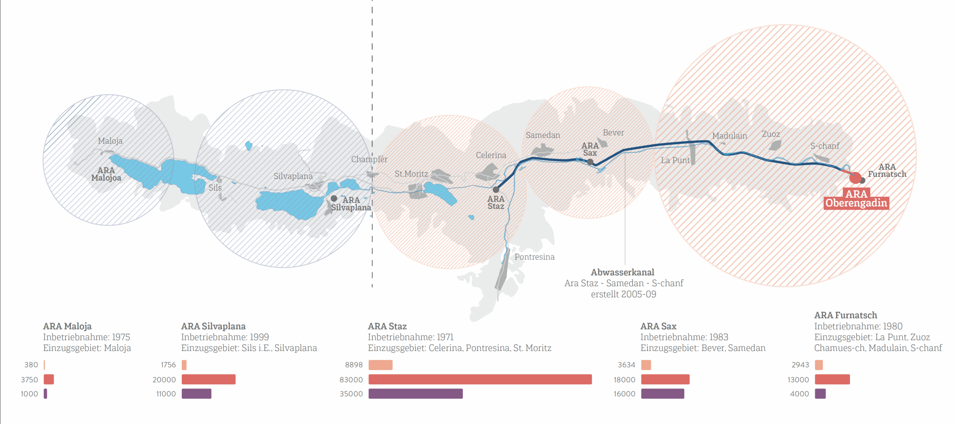
Local vs Regional View
The engadin valley
with the famous ski resort St. Moritz
1970
Local View – 5 treatment plants
1960
No treatment plants
Result:
Residual water section of the Inn of 35 km
with not effluent discharge in dry weather
2005 - 2009
Construction of the sewer
2001
First ideas
In the future
Regional View – 1 treatment plant
2011
Founding association with 9 communities
2021
Regional View – 2 treatment plants
Discharge in
hydroelectric plant
inflow channel
1
2
4
5
3
1
1
2
3
4
5
Notes:
1960 No treatment
1970 Local Plants – 5 plants
2001 First Ideas
2005 Construction of the sewer
2011 Founding new association
2021 Regional Plants – 2 plants
Result:
Discharge wastewater in inflow channel of the Engandiner Hydro energy plant system
No discharge of wastewater in the river «Inn» from St. Moritz to Zernez – over at distance of approximately 35 km

Slide 5
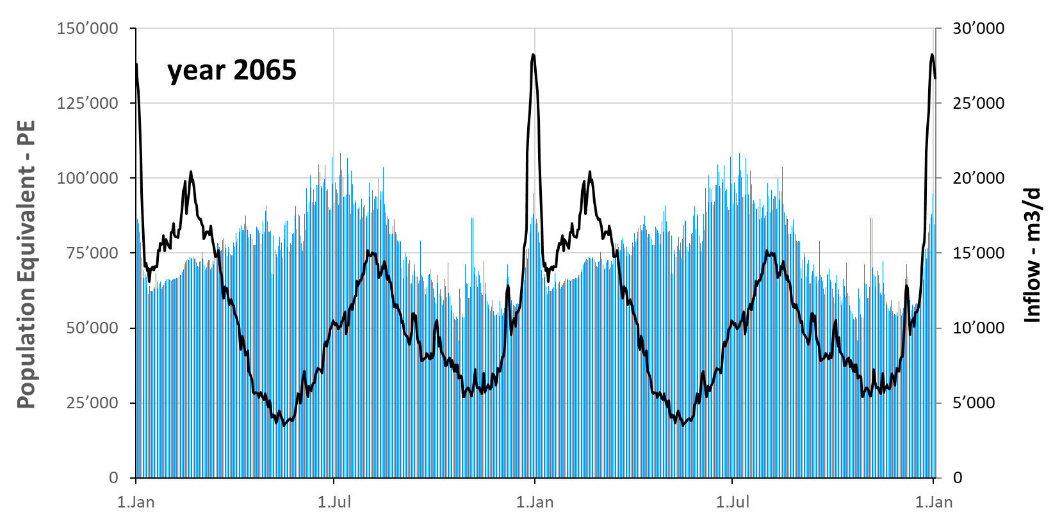
Plant Size – Influence of Tourism
90’000 PE
Notes:
highly variable inflow loads in a short time – for example in Dezember the load risies from 25’000 PE to 140’000 PE
Plantsize not dimensioned on the top peak between christmas und new year– chosen the average of the winter main saison
Variation over time – ammonium load and water amount differ highly depending on season
How can the plant capacity adapeted to the inflow load

Slide 6
Treatment Process – Adapting Capacity to variable Load
Inflow
Outflow
Primary treatment
Biologal treatment 5 SBR-reactors
Sludge treatment 3 digesters
2
5
1
3
4
Notes:
Modular – SBR-Technology allow to set one or more Reactors on standby from hours to days
The goal ist do prevent nitrification capacity to decay over time

Slide 7
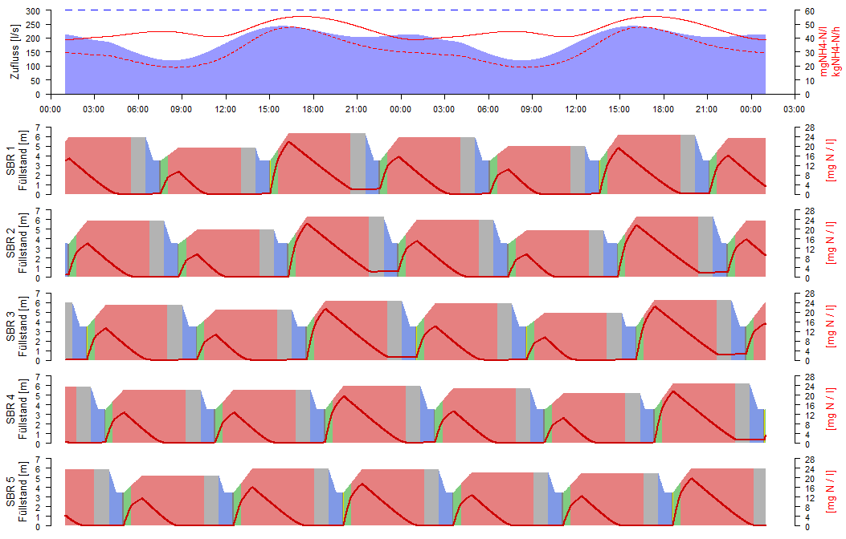
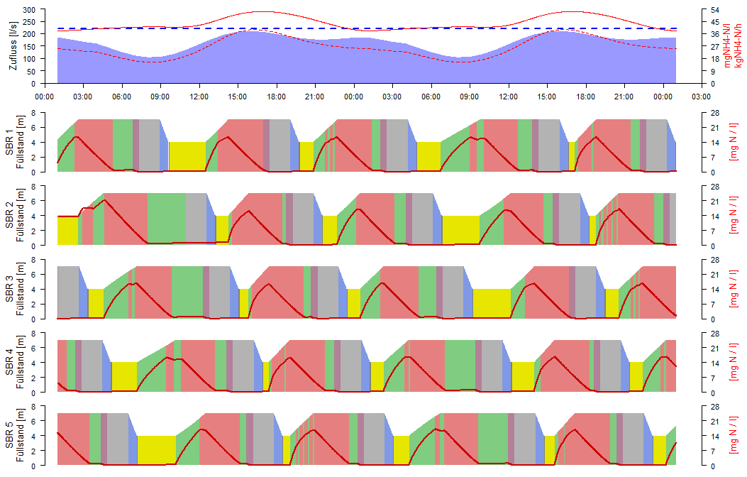
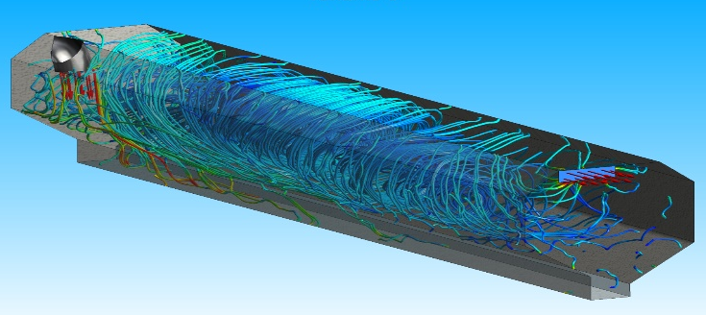
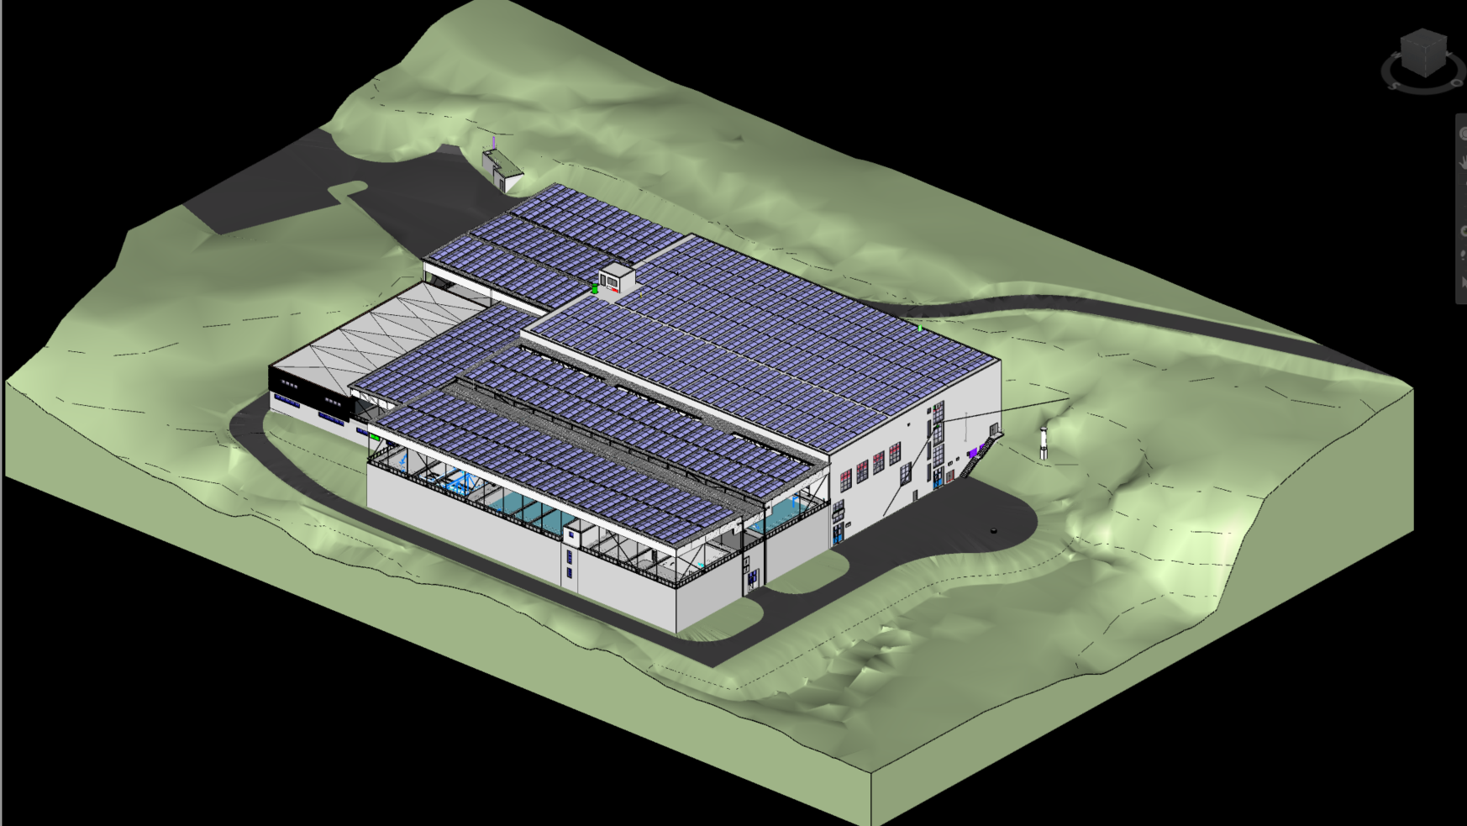
Applying modern Planning Tools
Wastewater Treatment Modelling
  Inflow prediction
  Dynamic Control of the Biological Treatment
CFD – Computational Fluid Dynamics
BIM – Building Information Modeling

Slide 8
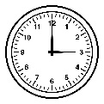
SBR – Prediction based dynamic control
Critical Cycle Duration =
Duration, until SBR must be ready for next filling, given the critical inflow
Prediction of Critical Inflow
→ defines cycle-duration
Prediction of times
→ Maximum for denitrification
→ Minimum for nitrification
→ Minimum for sedimentation
SBR 1 must be ready for next filling phase
time
current
time
Notes:
Predict cycle length
Predict in reaction phase the time max time for denitrification, min time für nitrification and sedimentation

Slide 9
SBR – Time Control vs Dynamic Control
Inflow
Improvement due to dynamic control
Inflow [l/s]
mg NH4-N/l
kg NH4-N/h
Acid Capacity
+ 15 %
Time Control
Level [m]
mg NH4-N/l
N-Elimination
> 75 %
Dynamic Control
Power Consumption
- 15 %
Level [m]
mg NH4-N/l
Denitrification
Nitrification
Past-Aeration
Sedimentation
Water discharge
Standby

Slide 10

Computational Fluid Dynamics – Grit Chamber
Optimize
  Place of Inflow and Outflow
  Geometrie of Cross Section
Shorten Chamber Length Reduce Length to Width Ratio from 10:1 to 6:1

Slide 11
BIM – WWTP Oberengadin
General Model for
Visualization
Construction
Process Engineering
Building Technology
  Heating
  Air Condition
  Sanitary
Elektro-technics
Notes:
BIM – ARO (2 Folien)
Erstellung Gesamtmodell für Bau, Verfahrenstechnik, HLKS und Elektroinstallationen
Planung der Ausführung nur am Modell -> Datenintegrität
Modell ist die einzige Datenquelle der Ausführungsunterlagen für Bau und Fachgewerke
Daten sind nachgeführt und in sich stimmig

Slide 12
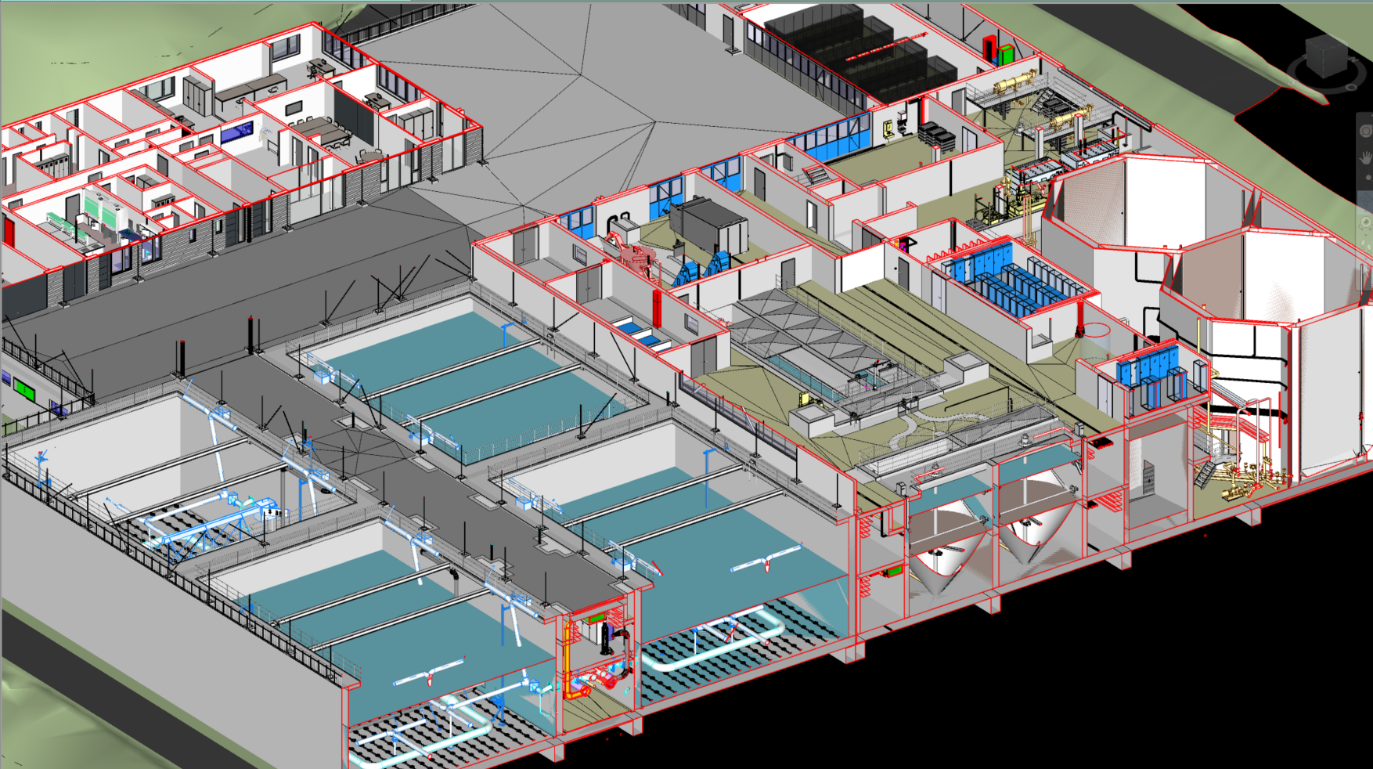
BIM – Planning WWTP Oberengadin
All plannerteams work with the same model
one model
data always up to date
data consistent
data integrity guaranteed

Slide 13
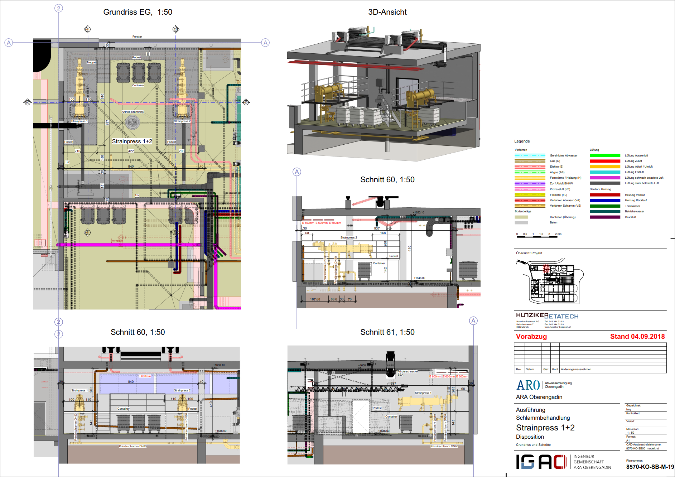
BIM – Planning Documents WWTP Oberengadin
Planning Documents
generated from the
model as needed
Consistent Plans
Notes:
Modell ermöglicht widerspruchsfreie Ausführungsunterlagen (z.B. Schnitte und Grundrisse)
Ausführungsunterlagen können nach Bedüfnissen erstellt werden (Modellauszüge, 3D Elemente, konventionelle Planunterlagen, Listen, etc.)

Slide 14
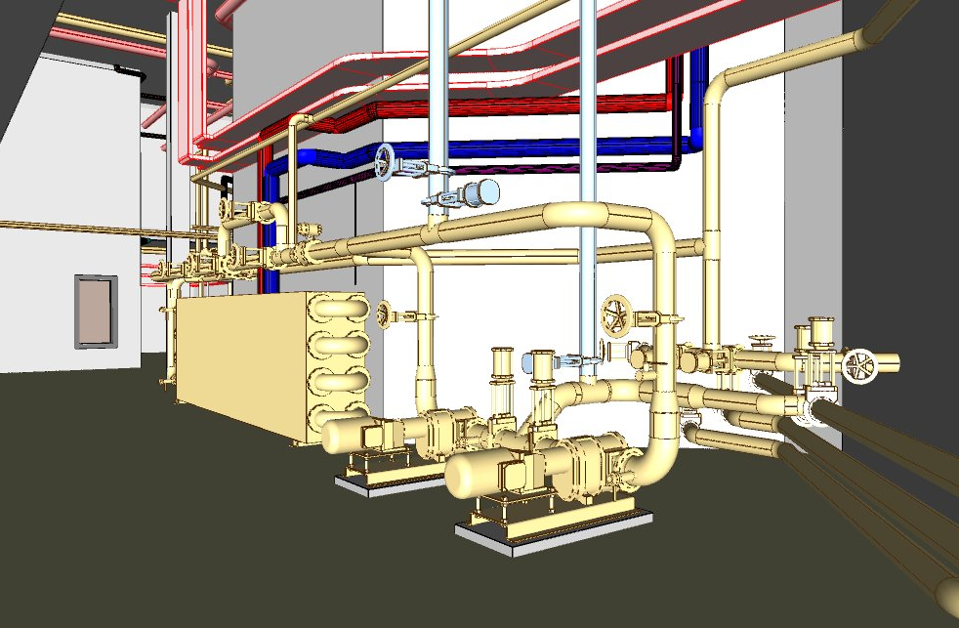
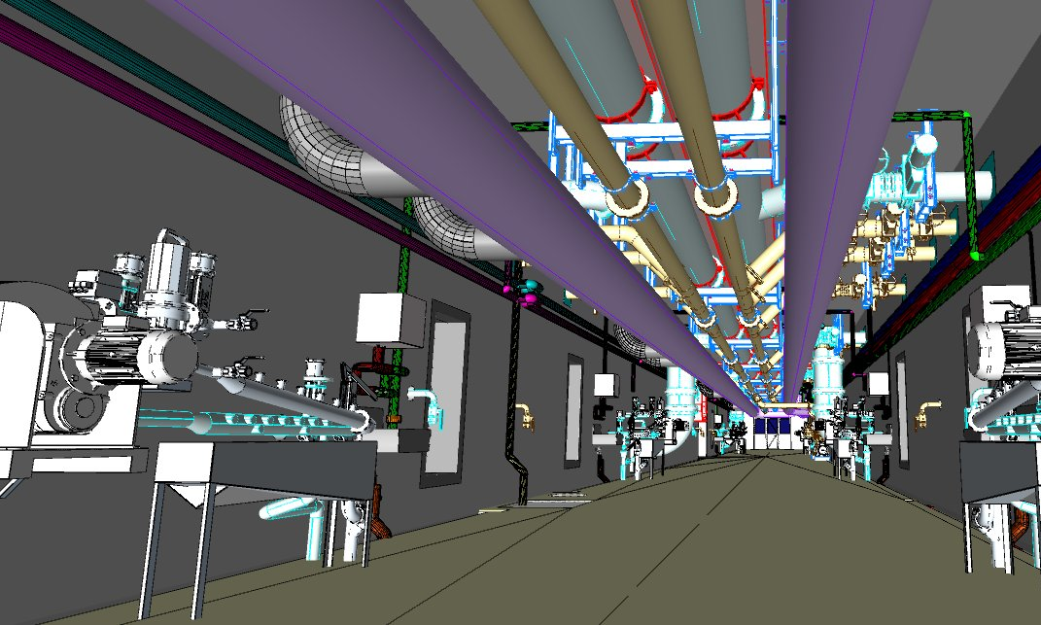
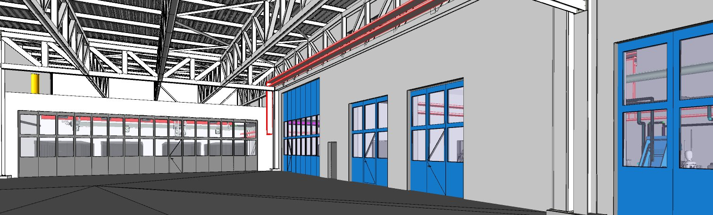
BIM – Virtual Reality WWTP Oberengadin
Dispositon of
equipment
Virtual Walk
What you see
is what you get!
Notes:
BIM – Virtual Reality
3D Modell: Begehung mit Brille
Visualisierung der Koordination, Maschinenaufstellung
What you see is what you get
Planungsmittel an Planersitzungen

Slide 15
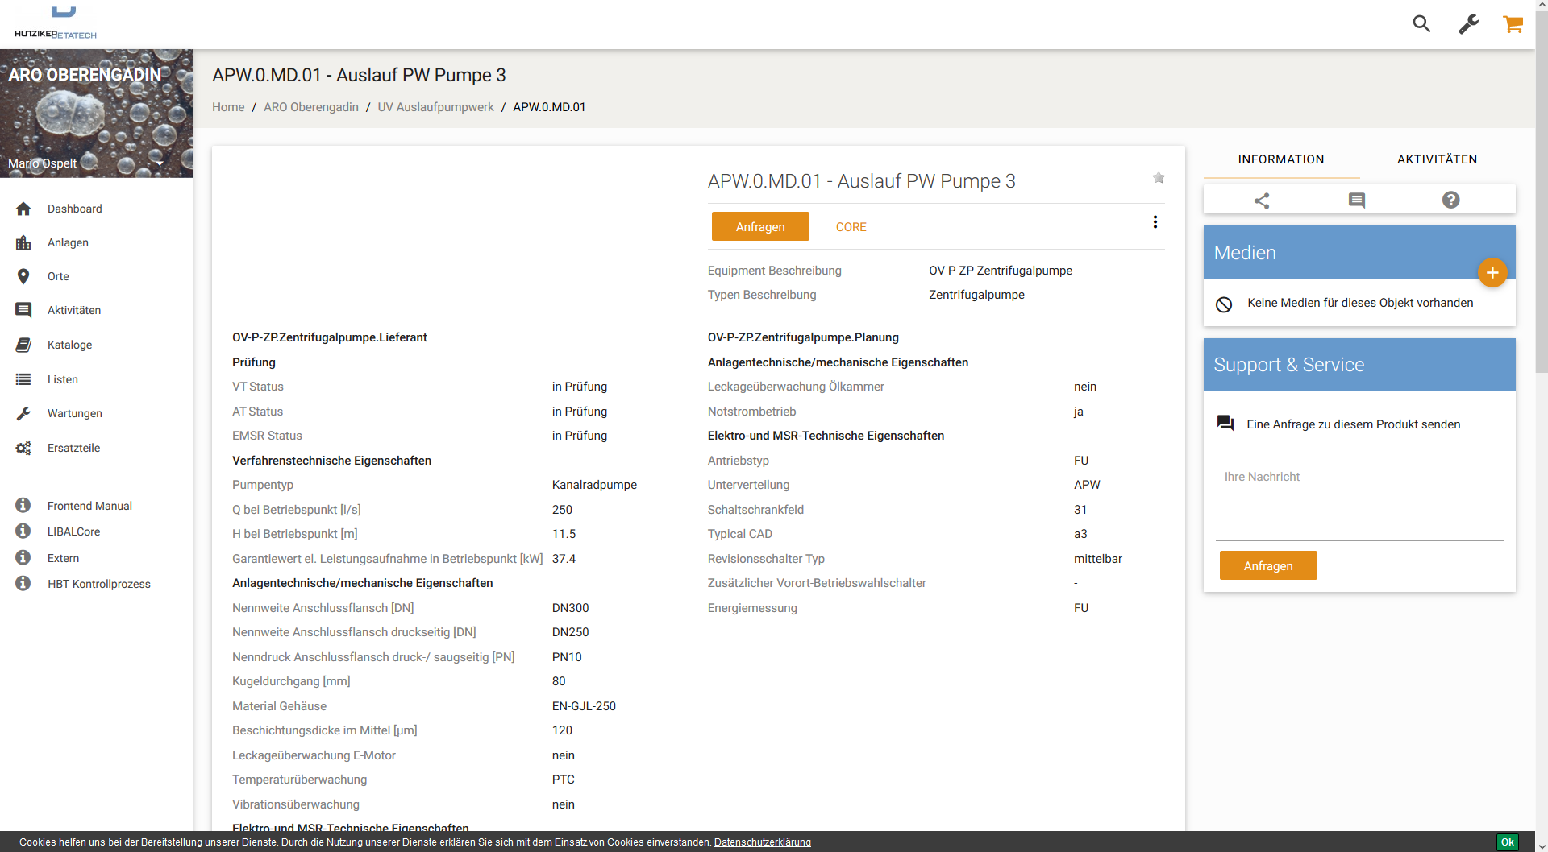
BIM –Data Base WWTP Oberengadin
Online Platform
Data Input by Contractors
Quality Control
Basis for planning the elektro-technics
Notes:
BIM – Data Collection
Online Plattform zur Erfassung der technischen Daten
Lieferanten tragen technische Daten ein und legen Dokumente der Dokumentation ab
Daten unterliegen einem QS Prozess mit Freigabe durch den Planer
Für die weitere Bearbeitung können entsprechende Listen generiert werden

Slide 16
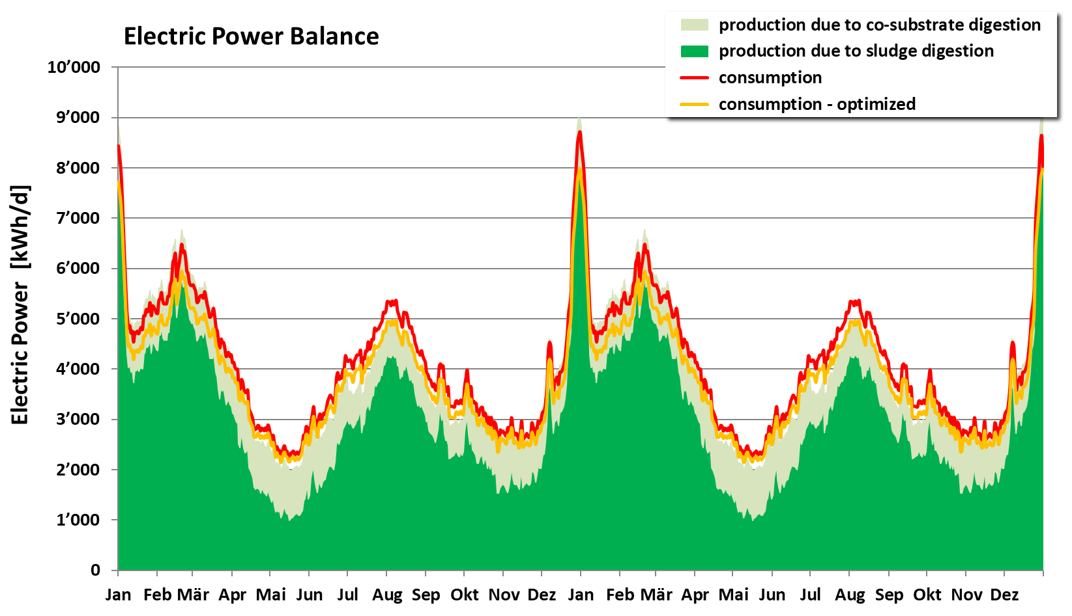
Electric Power – Production and Consumption
Specific
Consumption
32.9 kWh/PE*a
Optimized
30.7 kWh/PE*a
Heat supply
self-sufficent
Notes:
Solar panels on the roof not accauted because they are built by the local provider of electricity

Slide 17
Investment, Operating and Annual Costs
Capital Cost
Operating Cost
Investment Costs
  76.5 Mio CHF 66.5 Mio EUR
Operating Cost over 45 year
  87.5 Mio CHF 76.0 Mio EUR
Annual Cost
  Local Plants 7.36 Mio CHF
  WWTP Oberengadin 6.13 Mio CHF
    16.7 % or 1.23 Mio CHF less
Long-Term
Maintainance Cost
Notes:
Long –Term Maintanance Cost - Long-term Conservation of Value

Slide 18
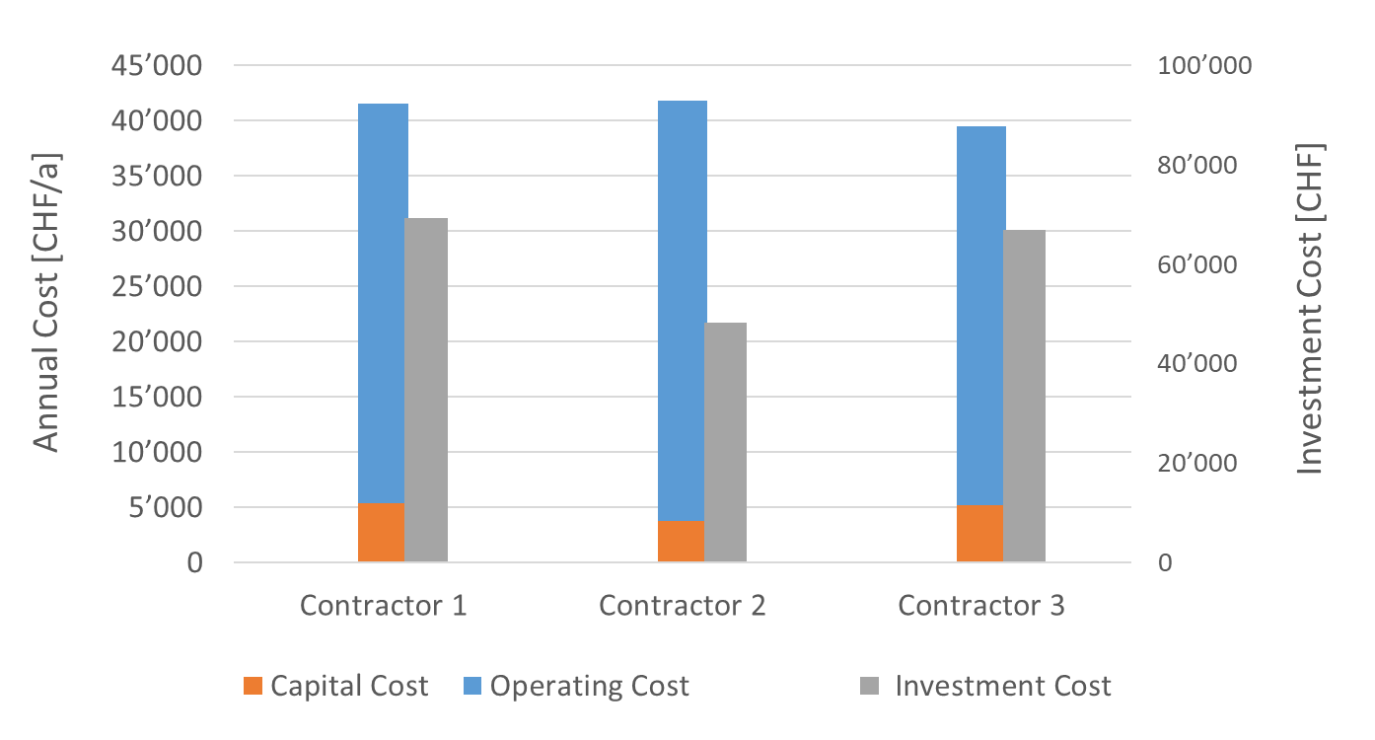
Comparison – Life Cycle Cost for Pumps

Slide 19
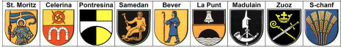
Project Organisation and Public Relations
Founding an association with 9 Communities
  Popular referendum in each Community
Project Financing – Credit
  Popular referendum in each Community
Project Organisation
Intercommunal Association
of 9 Communities
Executive Board
Project Leader
Association
General Planner
Engineer Team

Slide 20

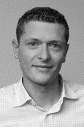

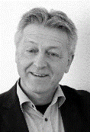

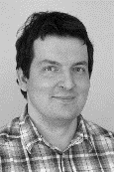
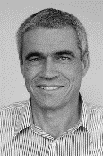
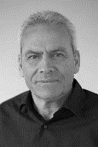

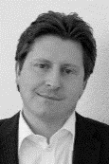


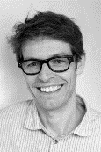


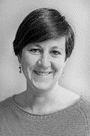
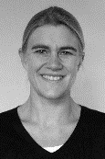
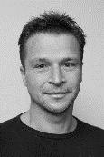
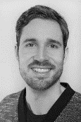
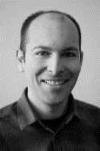



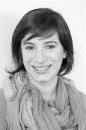



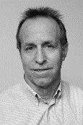
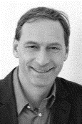
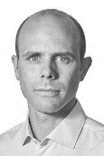

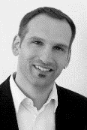
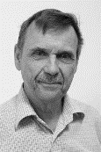


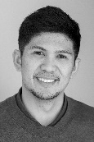





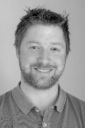

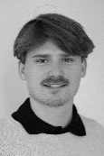

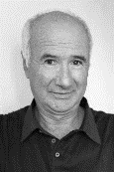
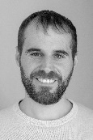
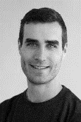
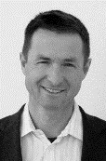




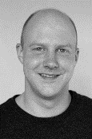



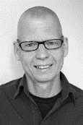

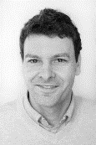
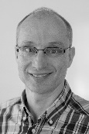






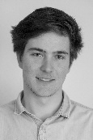
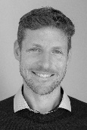


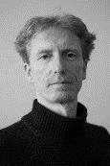



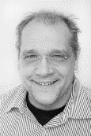
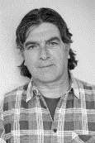







































































file:///R:\Infrastruktur\Betasystem\Vorlagen\Präsentation%20Vorlage.pptx
www.hunziker-betatech.ch

